Slide 1
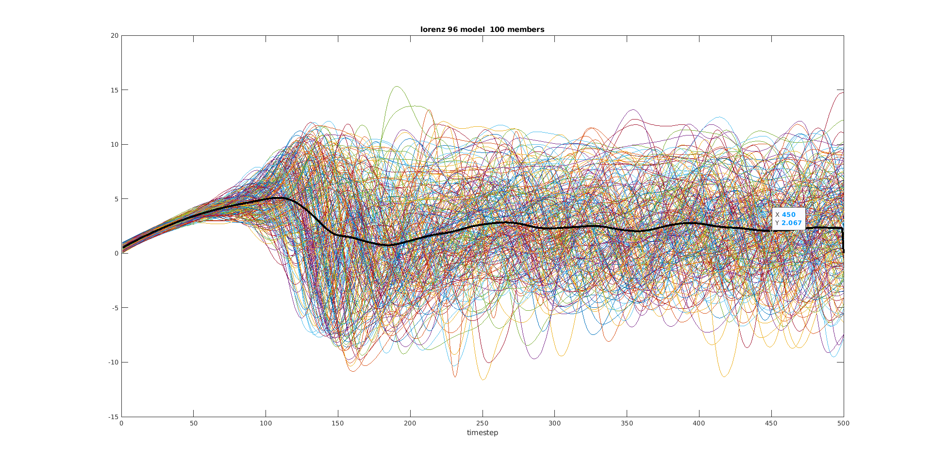

Slide 2
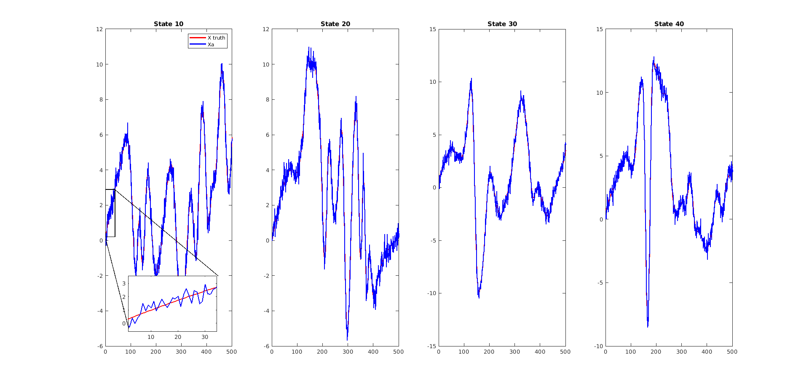
ENKF

Slide 3
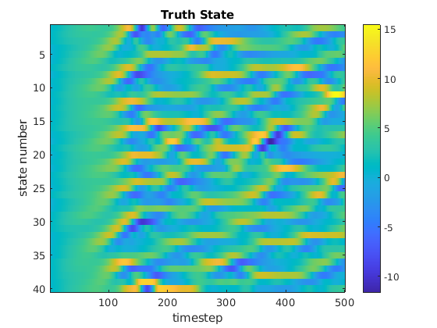
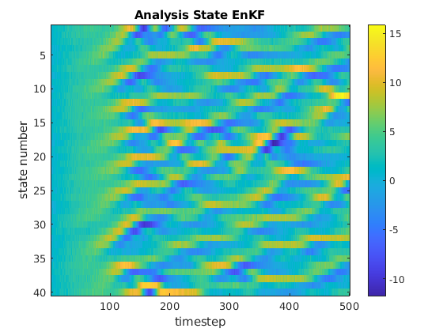

Slide 4
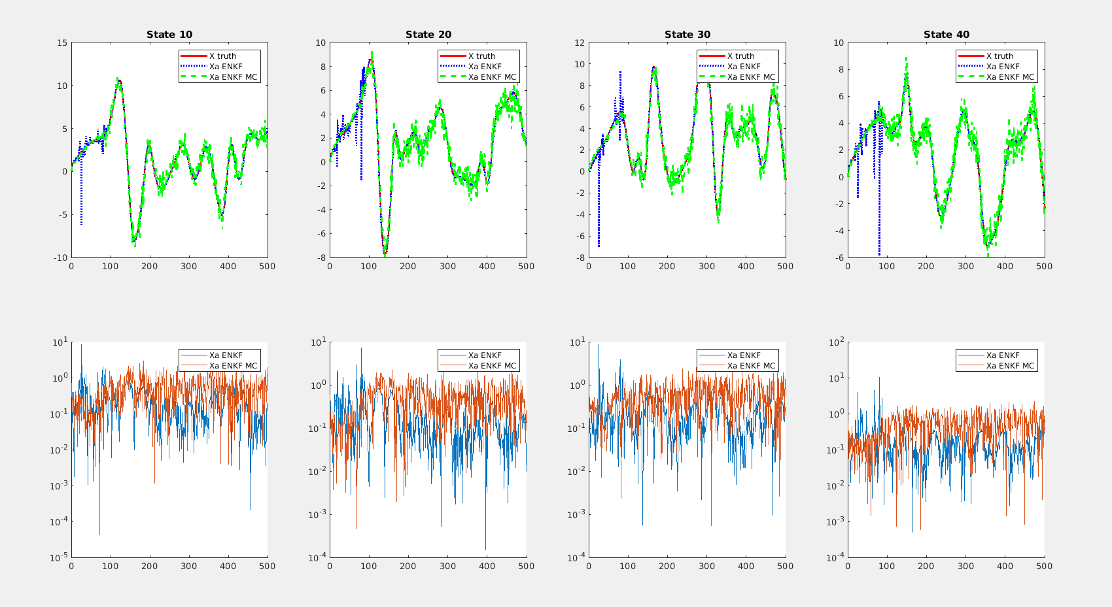

Slide 5
Results of MC-LORENZ96

Slide 6
MC-ENKF

Slide 7
ENKS

Slide 8
MC ENKS

